Slide 1
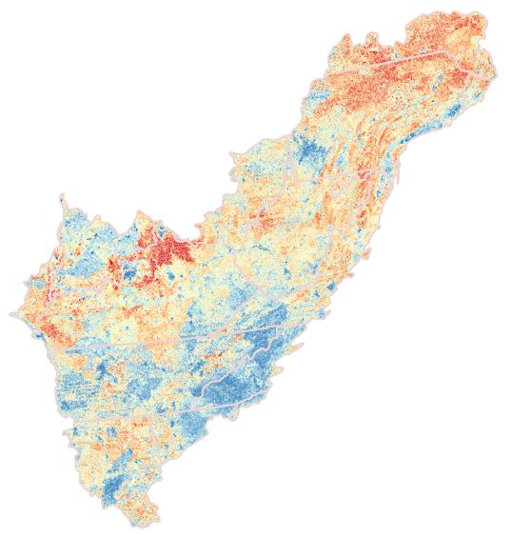
Appalachian Land Conservation Cooperative Landscape Conservation Design
An aquatic perspective
Daniel Hanks
Clemson University
rhanks@clemson.edu

Slide 2
Hypothetical biological response along a disturbance gradient
Biological Metric
Disturbance

Slide 3
Hypothetical biological response to a various landscape disturbances
Biological Metric
Landscape Gradient

Slide 4
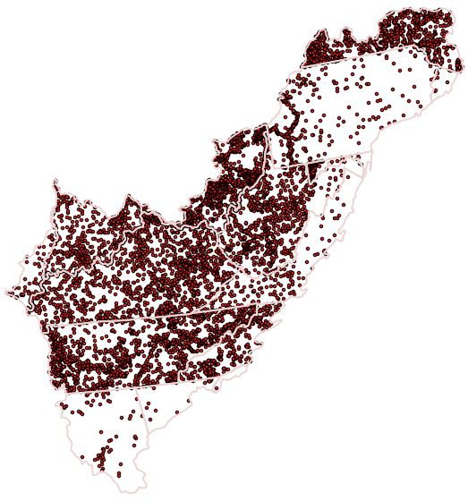
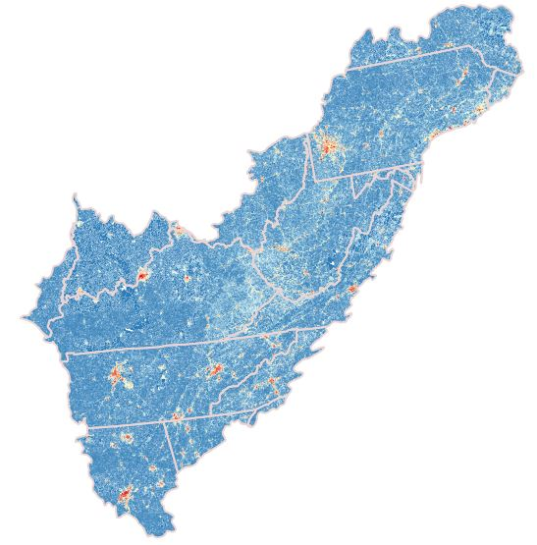
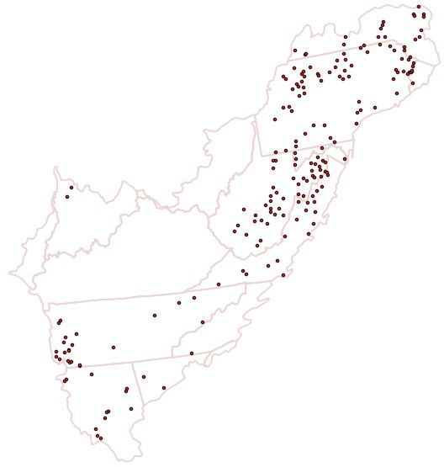
Known Response Variables
(poor spatial coverage)
Predictor Variables
(good spatial coverage)
Fish
Macroinverts

Slide 5
~
Known Response Variables
(poor spatial coverage)
Predictor Variables
(good spatial coverage)
Boosted Regression Trees
Relative Influence
Predicted Response Variables
(full spatial coverage)
Use RI to weight
predictors
f(X)
Goal: Identify key
biological targets
Goal: Identify key
abiotic targets

Slide 6
Final Predictors
Aquatic Habitat metric | Themes | Overall Predictors Score | RI weighted
Flow Alteration from Storage (total storage/mean annual flow) | Flow regime |  | Diversity
Density and type of dam
Altered streamflow
Agricultural water withdrawal
 |  |  | Fish FG
Industrial water withdrawal
Erosive Forces | Geomorphic condition
Resistive forces
Density of dams: Catchment | Connectivity
Density of dams: Watershed
 |  |  | Fish TQ
Density of crossings: Catchment
Density of crossings: Watershed
Nitrogen | Water Quality
Phosphorus
Dissolved Organic Carbon
 |  |  | Macroinverts TQ
% Impervious Surface in Watershed, Active River Area, & Catchment | Non-point sources of pollution
% Natural Cover in Watershed & Active River Area
% Agriculture in Watershed, Active River Area, & Catchment
 |  |  | Fish
Comprehensive Environmental Response, Compensation, and Liability Information System site density | Point sources of pollution
Permit Compliance System site density
Toxic release inventory site density in Watershed and Catchment
 |  |  | Macroinverts
Coal mine density
Wind turbine density
All mine density in Watershed and Catchment
Natural gas well density
Regions
AppLCC
Atlantic Highlands
Ozark-Ouachita Appalachian
Southeastern Plains
Notes:
We compiled predictor variables for flowlines from 3 primary datasets. NFHP, TNC Aquatic Classification, StreamCat

Slide 7
Final Responses
Biological metric | Targets | Condensed Attributes | Overall Response Score
Diversity | Shannon Diversity | Fish Score
Invertivore Taxa | Functional Group
Piscivore Taxa
Herbivore Taxa
Lithophilic Spawners | Fish Taxa Quality
Taxa Preferring Coarse Sediment
Intolerant Taxa
Tolerant Taxa
EPT Taxa | Macroinverts Taxa Quality | Macroinverts Score
5 Dominant Taxa
Intolerant Taxa
Tolerant Taxa
Regions
AppLCC
Atlantic Highlands
Ozark-Ouachita Appalachian
Southeastern Plains
Notes:
We compiled predictor variables for flowlines from 3 primary datasets. NFHP, TNC Aquatic Classification, StreamCat

Slide 8
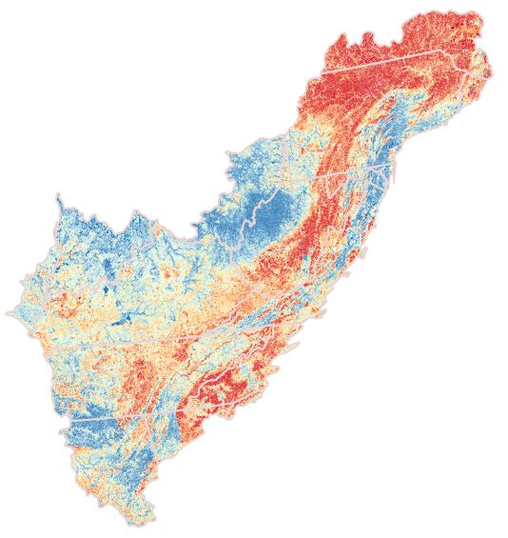
Response: fish richness
Variable | RI
Elevation | 13.8
Temperature (July) | 11.3
R-factor (runoff factor) | 9.8
NID Storage | 8.1
K-factor (soil erodibility) | 4.9
% Natural Cover (ARA) | 4.6
% Agricultural Cover (ARA) | 4.5
Baseflow | 4.5
Poor
Themes | Avg RI
Flow | 3.1
Geomorphic condition | 7.4
Connectivity | 1.0
Water quality | 1.4
Non-point source pollution | 2.9
Point source pollution | 0.2
Good

Slide 9
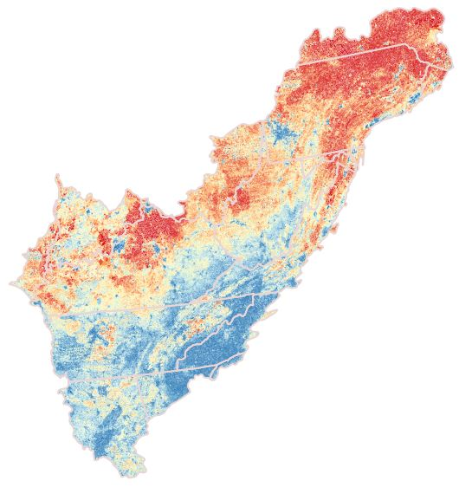
Response: taxa quality
Fish Taxa Quality
Macroinverts Taxa Quality
Poor
Good

Slide 10
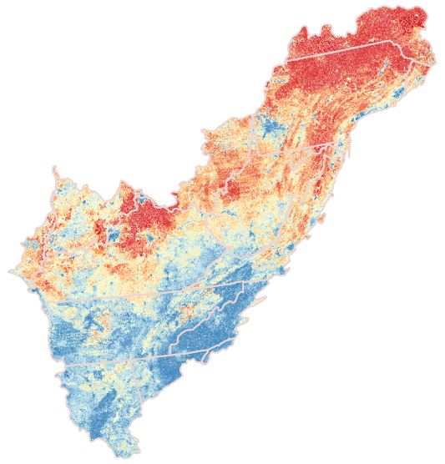
Response: overall WS score
Variable | RI
R-factor (runoff factor) | 7.8
Elevation | 7.8
Temperature (July) | 9.8
Baseflow | 6.7
NID Storage | 6.5
Nitrogen (Catchment) | 6.1
% Impervious Cover (ARA) | 5.2
K factor | 5.1
Poor
Themes | Avg RI
Flow | 2.6
Geomorphic condition | 6.5
Connectivity | 1.3
Water quality | 2.6
Non-point source pollution | 3.0
Point source pollution | 0.3
Good

Slide 11
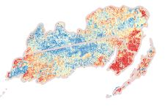
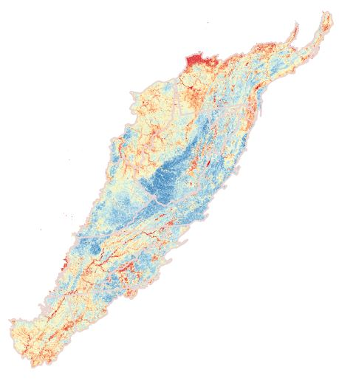
Regional models: differences exist
Variable | RI
Nitrogen (Catchment) | 7.7
K-factor (soil erodibility) | 6.5
% Impervious Cover (ARA) | 6.2
R-factor (runoff factor) | 5.2
Silt | 5.0
Base flow | 5.0
Elevation | 4.9
% Natural Cover (ARA) | 4.8
Poor
Good
Variable | RI
Sand | 8.5
R-factor (runoff factor) | 7.8
Elevation | 7.6
NID Storage | 6.2
% Impervious Cover (ARA) | 5.8
Base flow | 5.4
K-factor (soil erodibility) | 5.2
Nitrogen (Catchment) | 4.7
Variable | RI
Base flow | 7.3
Temperature (July) | 7.1
NID Storage | 6.9
Nitrogen (Catchment) | 6.6
Elevation | 6.5
R-factor (runoff factor) | 6.0
K-factor (soil erodibility) | 5.8
% Impervious Cover (ARA) | 5.0

Slide 12
Regional models: differences exist
Themes | Avg RI
Flow | 2.1
Geomorphic | 5.8
Connectivity | 1.7
Water Quality | 3.1
Non-point source pollution | 4.0
Point-source pollution | 0.2
Poor
Good
Themes | Avg RI
Flow | 2.3
Geomorphic | 6.5
Connectivity | 1.4
Water Quality | 1.7
Non-point source pollution | 3.4
Point-source pollution | 0.3
Themes | Avg RI
Flow | 2.6
Geomorphic | 5.9
Connectivity | 1.3
Water Quality | 3.3
Non-point source pollution | 3.0
Point-source pollution | 0.2

Slide 13
Response: overall WS score
Overall WS score
Single BRT model
Overall WS score
Regional BRT models
Poor
Good

Slide 14
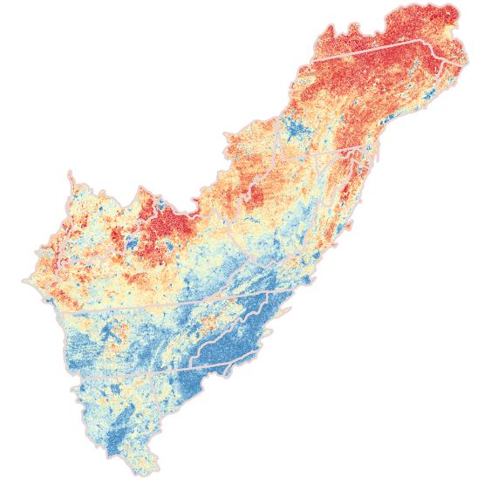
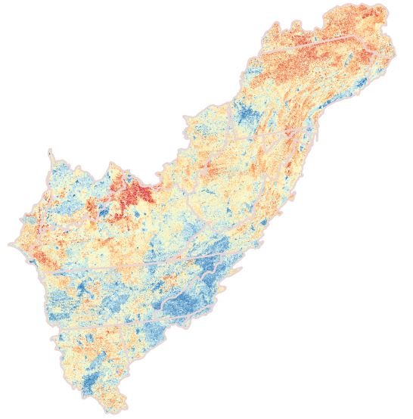
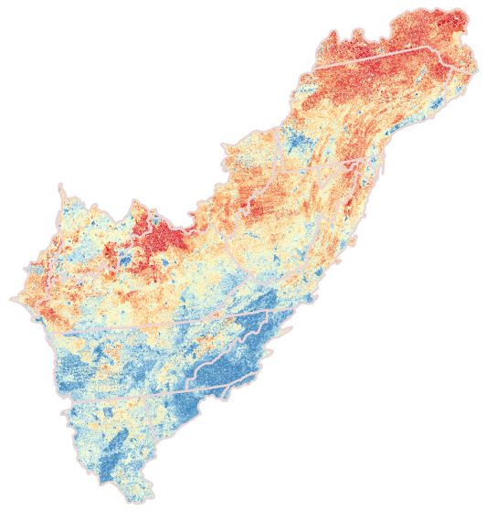
Predictors: Overall weighted WS scores
Fish Taxa Quality
Macroinvert Taxa Quality
Grand Average
Poor
Good
Themes | Avg RI
Flow | 2.8
Geomorphic | 6.2
Connectivity | 1.3
Water Quality | 1.7
Non-point source pollution | 3.3
Point-source pollution | 0.3
Themes | Avg RI
Flow | 2.0
Geomorphic | 6.5
Connectivity | 1.9
Water Quality | 6.5
Non-point source pollution | 3.2
Point-source pollution | 0.2
Themes | Avg RI
Flow | 2.3
Geomorphic | 5.1
Connectivity | 1.6
Water Quality | 4.3
Non-point source pollution | 3.1
Point-source pollution | 0.3

Slide 15
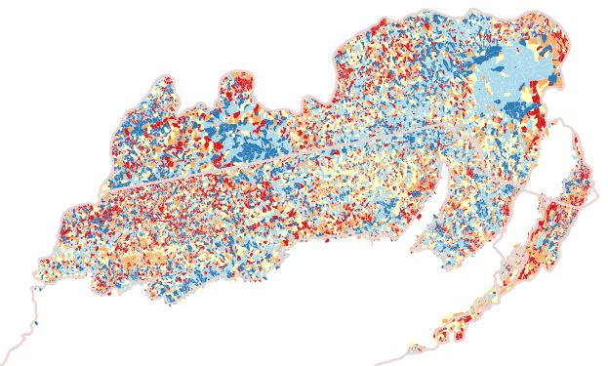
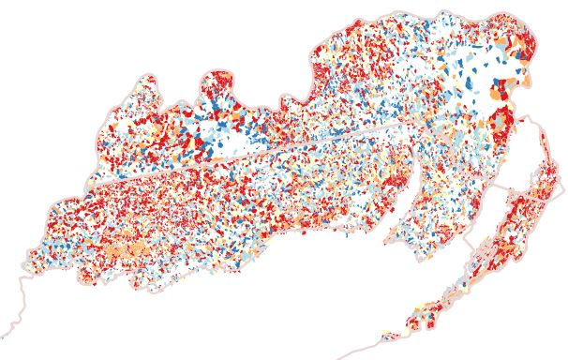
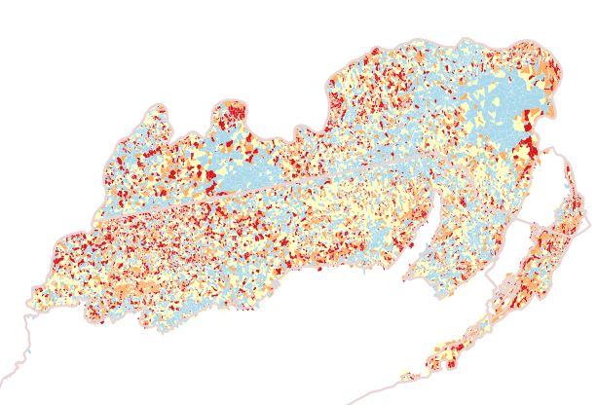
Predictors: Regional categorical weighted WS scores (connectivity)
Grand Average
Macroinverts
Fish
Poor
Good

Slide 16
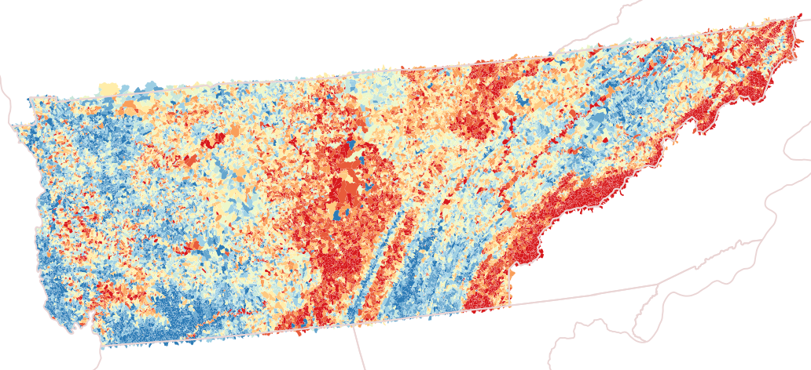
Tennessee fish richness
Variable | RI
Nitrogen (Catchment) | 10.0
Temperature (July) | 9.5
NID storage | 8.9
R-factor | 8.4
Elevation | 5.6
Base flow | 5.0
% Impervious cover (ARA) | 4.2
% impervious cover | 4.6
Themes | Avg RI
Flow | 3.4
Geomorphic condition | 6.1
Connectivity | 1.8
Water quality | 3.4
Non-point source pollution | 3.5
Point source pollution | 0.4
Poor
Good

Slide 17
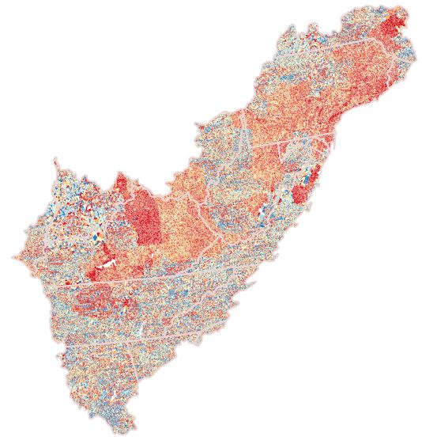
Issues to be addressed
Data resolution
WS size
Data availability
Lack of response data
Spatial distribution of data
large
small

Slide 18
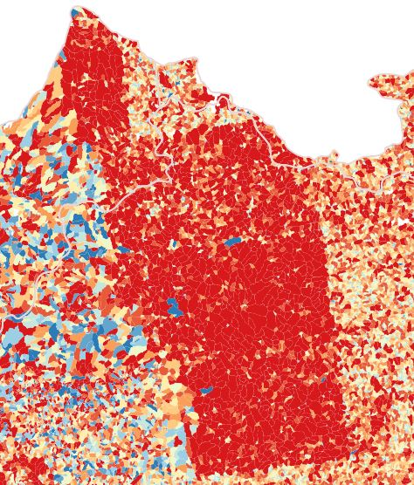
Issues to be addressed
Data resolution
WS size
Data availability
Lack of response data
Spatial distribution of data

Slide 19
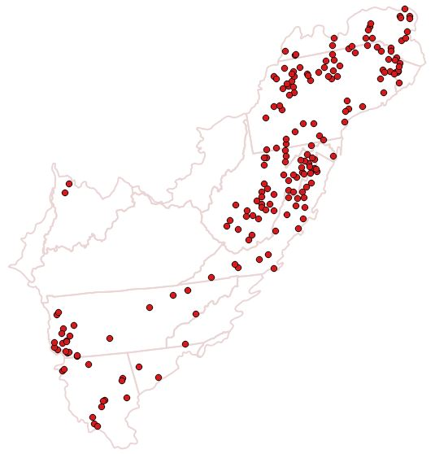
Issues to be addressed
Data resolution
WS size
Data availability
Lack of response data
Spatial distribution of data

